Slide 1


Building a Repository to Handle the application’s data requirement
Belal Khan
Developer Advocate, Stream
India

Slide 2
Common Architectural Principle

Slide 3
Separation of Concern
Minimize dependency on activity/fragment classes

Slide 4
Driving UI from a Model
Your users don't lose data if the Android OS destroys your app to free up resources.
Your app continues to work in cases when a network connection is flaky or not available.

Slide 5
Recommended App Architecture

Slide 6
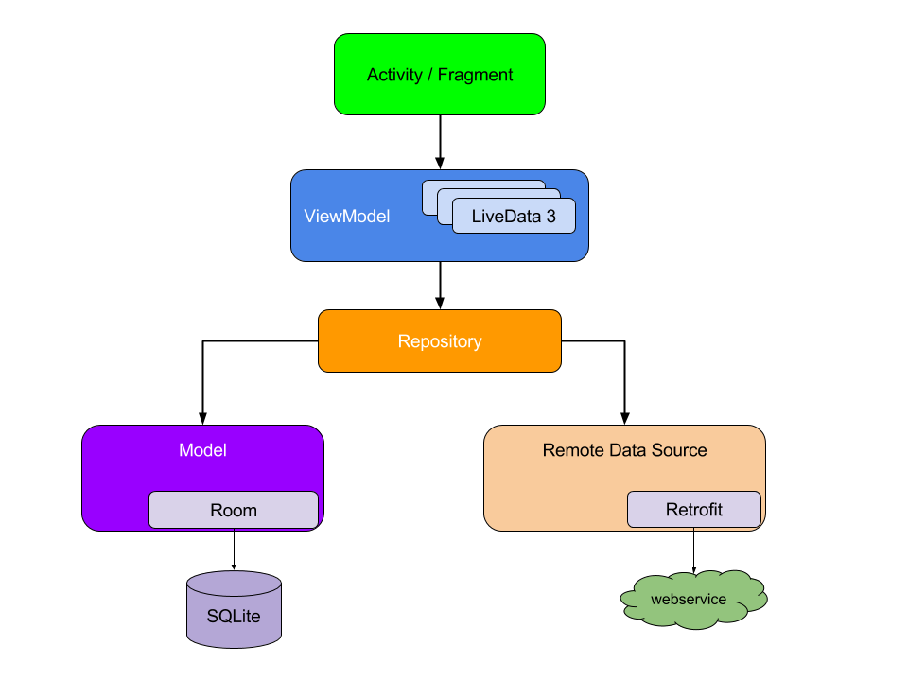

Slide 7
Repository

Slide 8
Why Repository?
Provides a clean API for rest of the apps.

Slide 9
Sample Repository
class UserRepository @Inject constructor(
private val api: UsersApi
) {
fun getUsers() = api.getUsers()
}

Slide 10
Caching Data

Slide 11
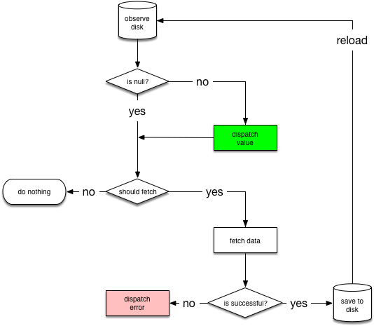

Slide 12
Networkbound Resource
inline fun <ResultType, RequestType> networkBoundResource(
crossinline query: () -> Flow<ResultType>,
crossinline fetch: suspend () -> RequestType,
crossinline saveFetchResult: suspend (RequestType) -> Unit,
crossinline shouldFetch: (ResultType) -> Boolean = { true }
) = flow {
val data = query().first()
val flow = if (shouldFetch(data)) {
emit(Resource.Loading)
try {
saveFetchResult(fetch())
query().map { Resource.Success(it) }
} catch (throwable: Throwable) {
query().map { Resource.Failure(throwable) }
}
} else {
query().map { Resource.Success(it) }
}
emitAll(flow)
}

Slide 13
Repository
class UserRepository @Inject constructor(
private val api: UsersApi,
private val userDao: UserDao
) {
fun getUsers() = networkBoundResource(
query = { userDao.getUsers() },
fetch = { api.getUsers() },
saveFetchResult = { userDao.addUsers(it.data) },
shouldFetch = { it.isEmpty() }
)
}

Slide 14
MainActivity
override fun onCreate(savedInstanceState: Bundle?) {
super.onCreate(savedInstanceState)
binding = ActivityMainBinding.inflate(layoutInflater)
setContentView(binding.root)
binding.recyclerView.adapter = adapter
viewModel.users.observe(this) { resource ->
if (resource is Resource.Success) {
adapter.submitList(resource.value)
}
}
}

Slide 16
Get the Full Project
https://github.com/probelalkhan/repository-pattern

Slide 17
Some Interview Questions
Why we should build a Repository?
Disadvantages of writing network calls in Activity/Fragment.
Importance of app architecture.
How ViewModel survives configuration changes.
What you will choose between LiveData and Flow?

Slide 18
Thank You!
Belal Khan
Developer Advocate, Stream
India

